Slide 1

EVIZON
(From Chaos to Clarity)
“AI-powered Event Photo Tagging & Archival System”
Team ZenX Labs | Brainware AI Hackathon

Slide 2
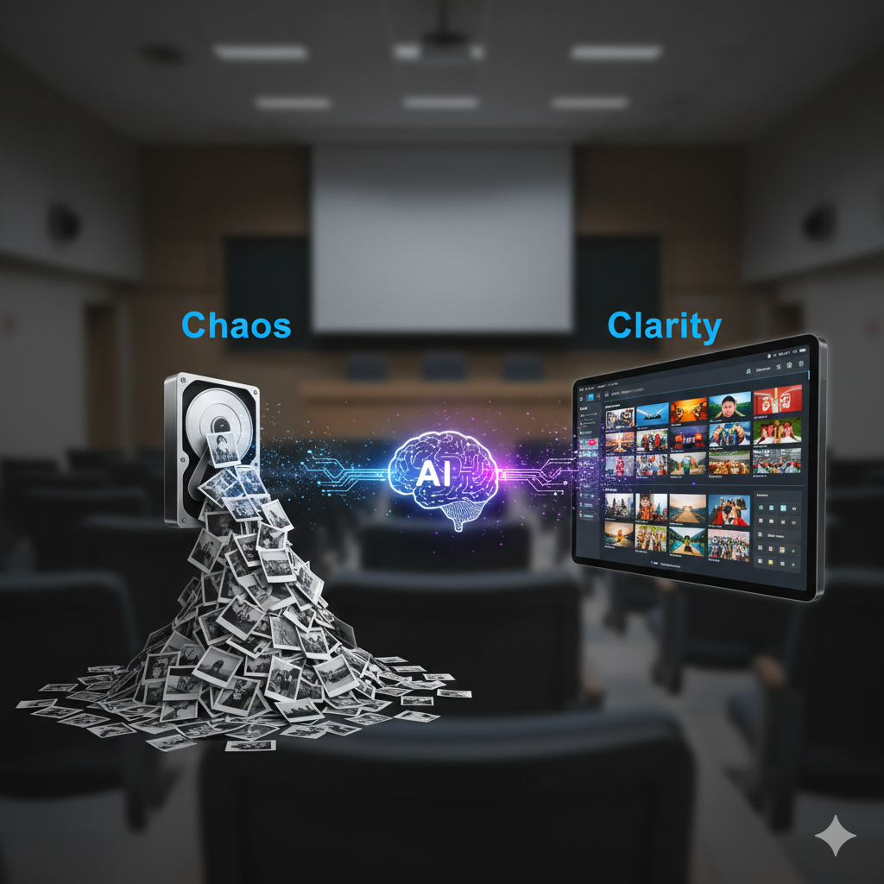
The Hidden Chaos in University Event Photos
Hundreds of photos per event
Stored randomly across drives
Manual sorting takes hours
Documentation becomes painful
No centralized, searchable event archive

Slide 3

Why This Is a Serious Problem
1 event → 200–400 photos
10–12 hours of manual effort
High chance of data loss
Affects NAAC, website, media teams
Repeats every semester across all departments

Slide 4
Meet Evizon!
An AI system that automatically understands, tags, cleans, and organizes university event photos.
Upload
AI Analyzes
Album Ready

Slide 5
Key Capabilities
Event type detection
Banner & poster text reading (OCR)
Object & scene tagging
Face clustering (privacy-safe)
Blur & duplicate removal
Event-wise album creation
Detection
Organization
Cleaning
Creation

Slide 6
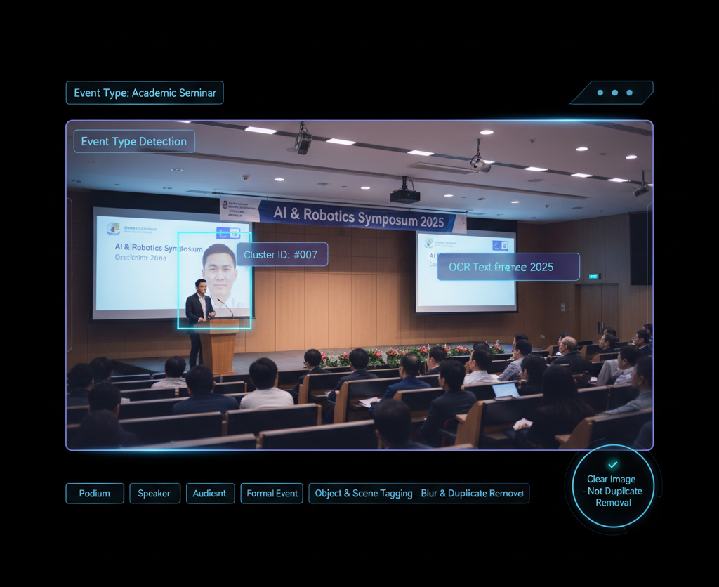
How Evizon Works ?
Workflow of Evizon :
Upload event photos
Vision AI + OCR analysis
Tagging, clustering & filtering
Structured event albums generated
Download & archive

Slide 7
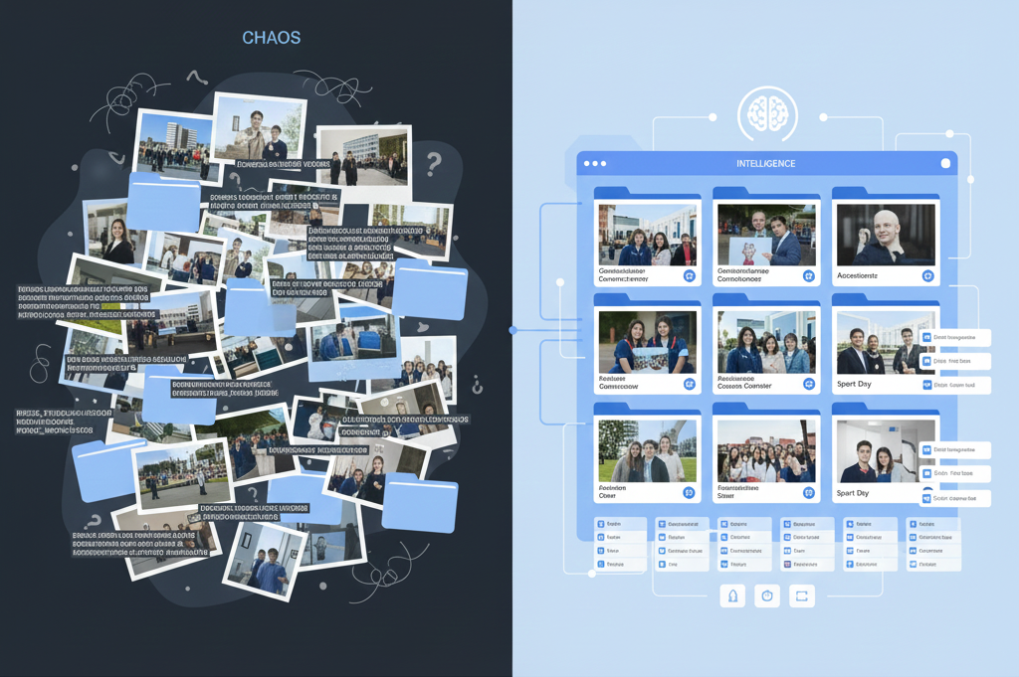
Why Evizon Stands Out!
Built specifically for university documentation
Not a generic photo organizer
Privacy-safe face clustering
End-to-end automation
Scalable across institutions

Slide 8

Tech Behind Evizon
AI / Vision Models
Text & Image Processing
YOLOv8
MediaPipe
OpenCV
Tesseract OCR
EasyOCR
Backend & Logic
Frontend & Storage
Python
FastAPI
React
Supabase / Firebase

Slide 9

Thank You
“Evizon transforms university memories into structured intelligence.”
We respect your Attention for Us! Any Questions?
Team ZenX Labs | Brainware AI Hackathon

